Slide 1

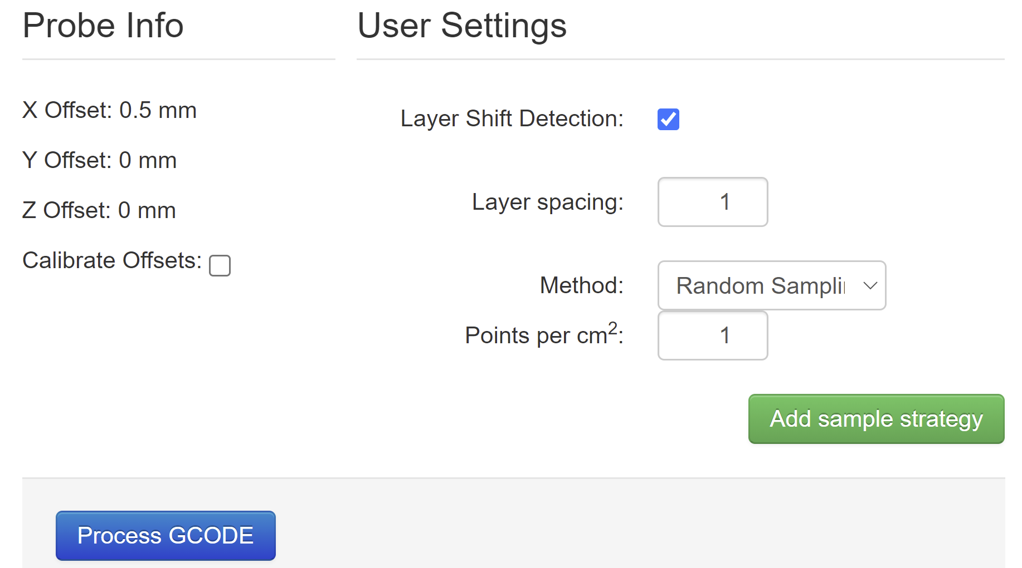


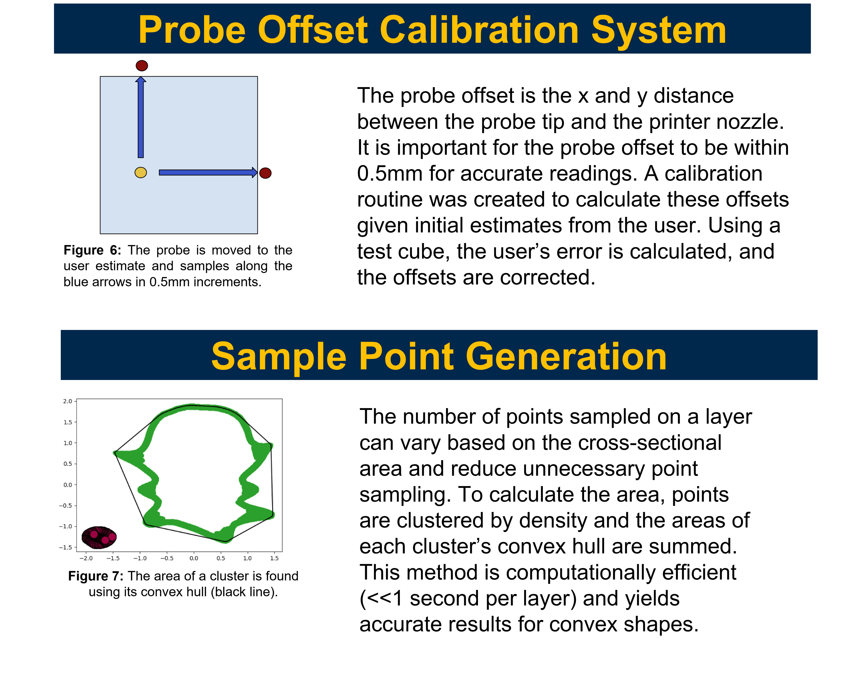
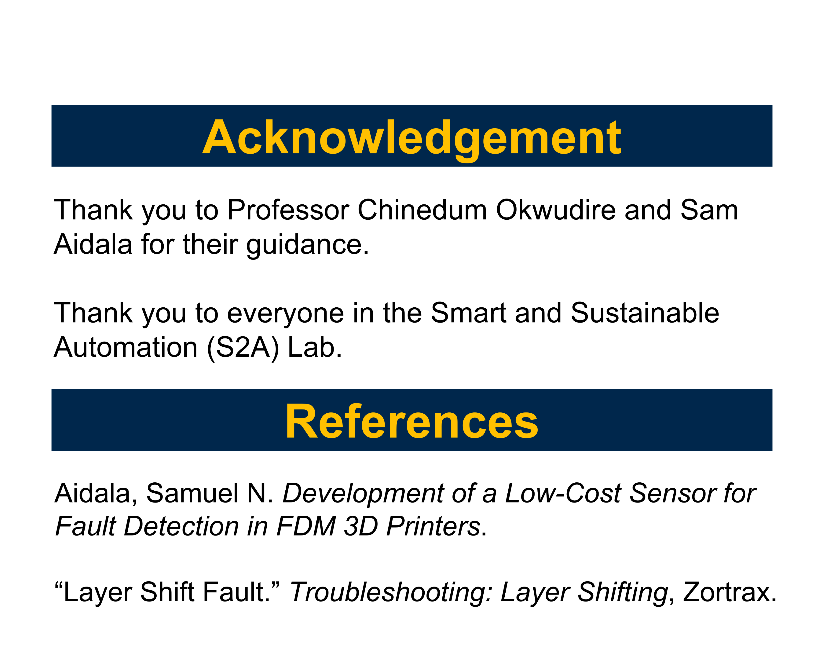
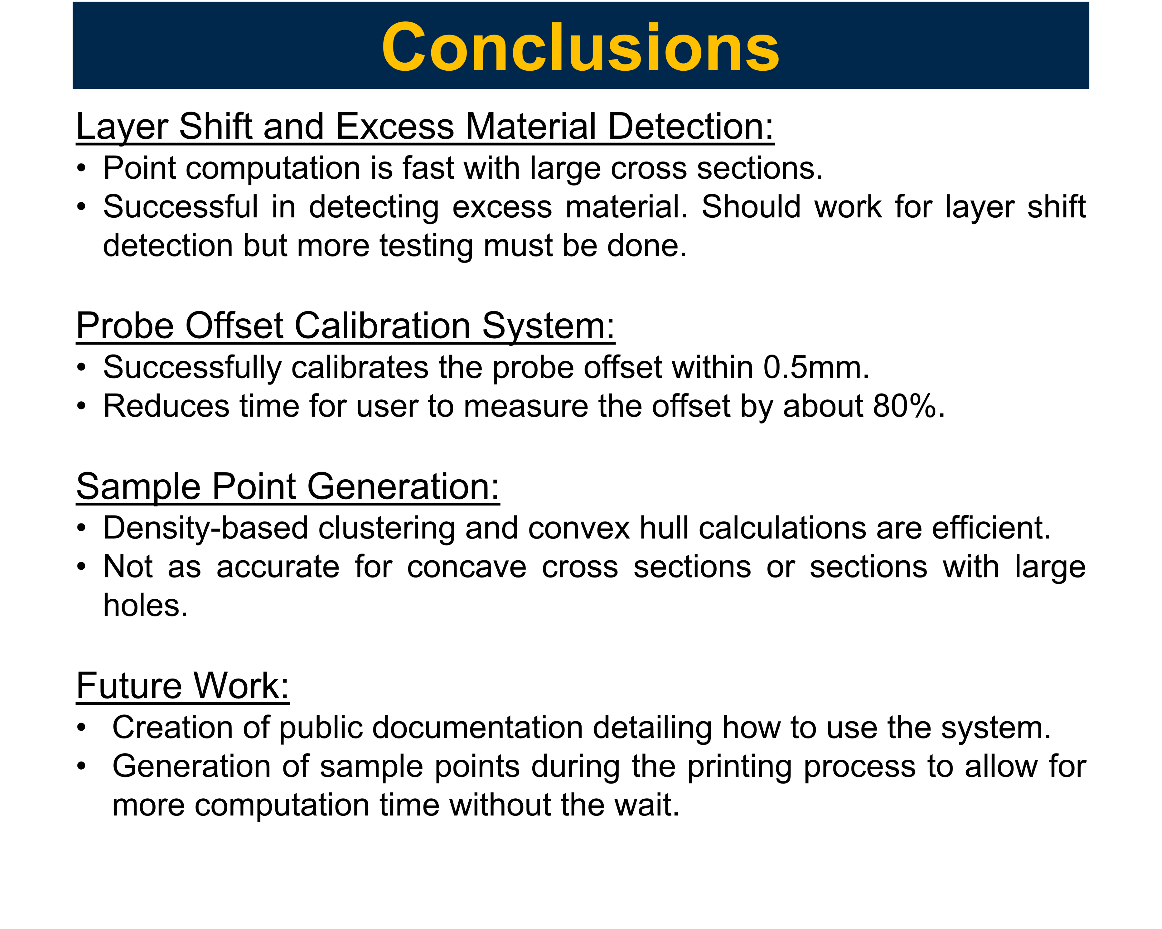
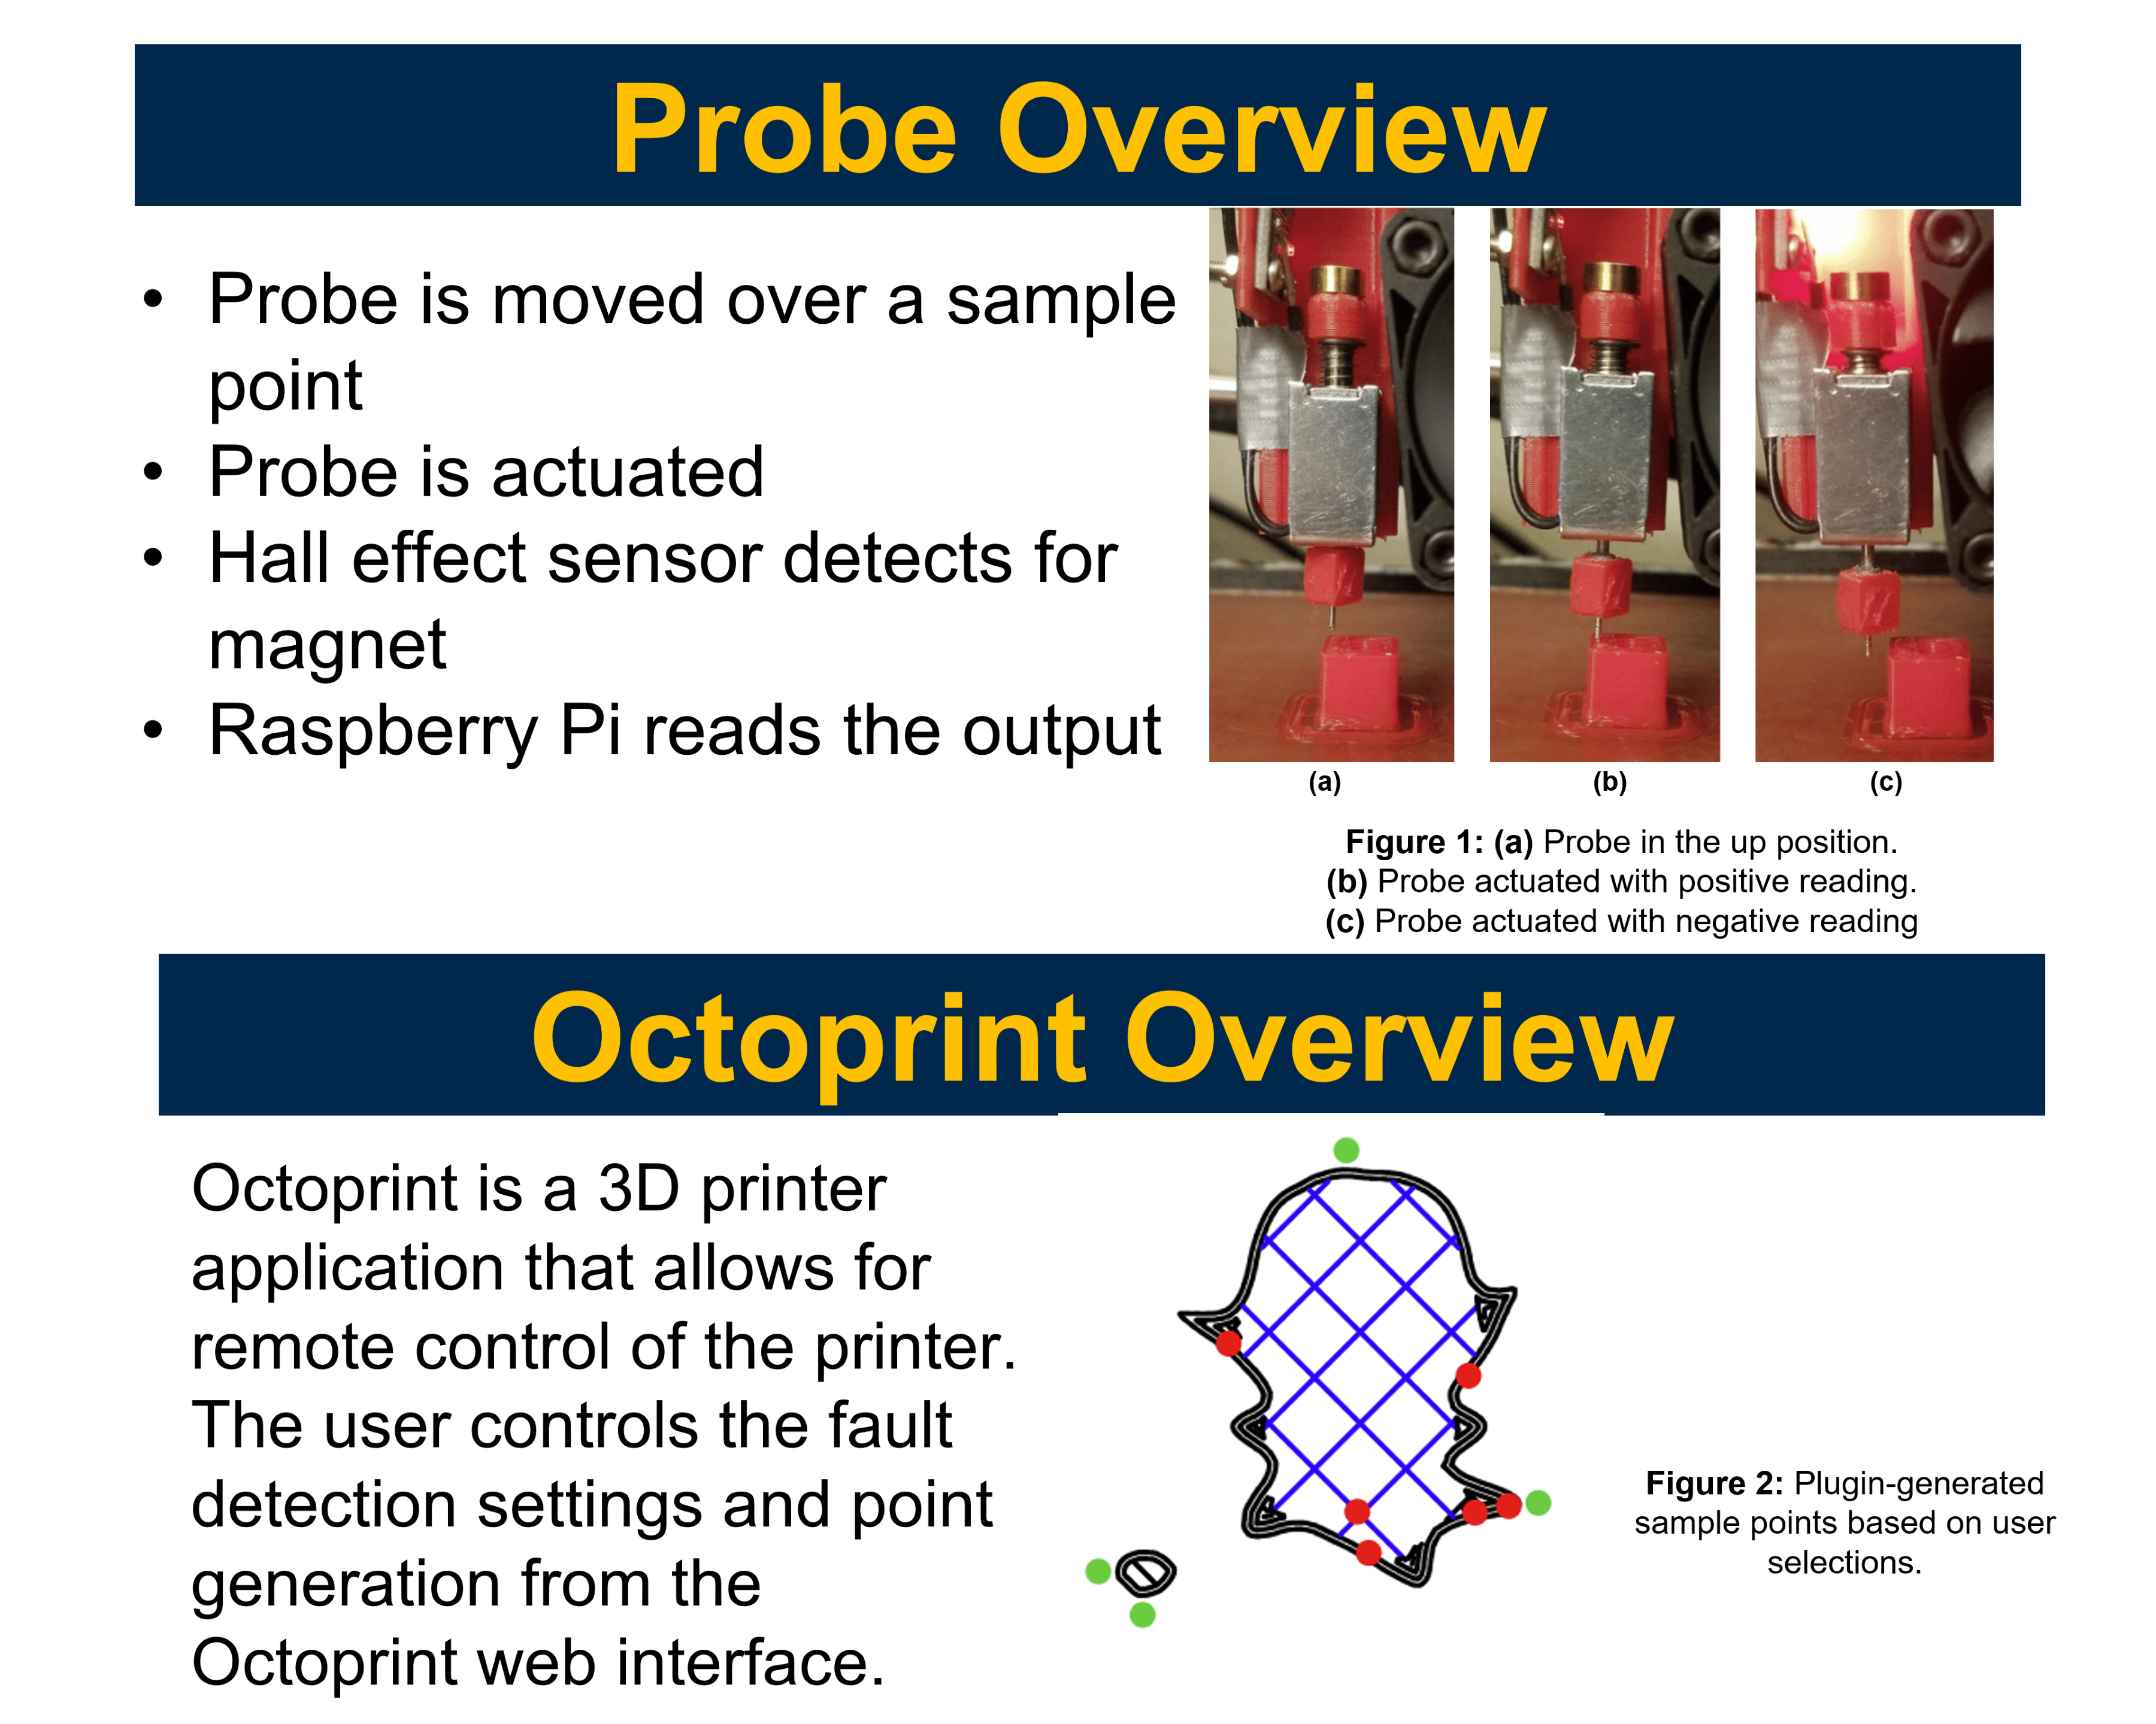
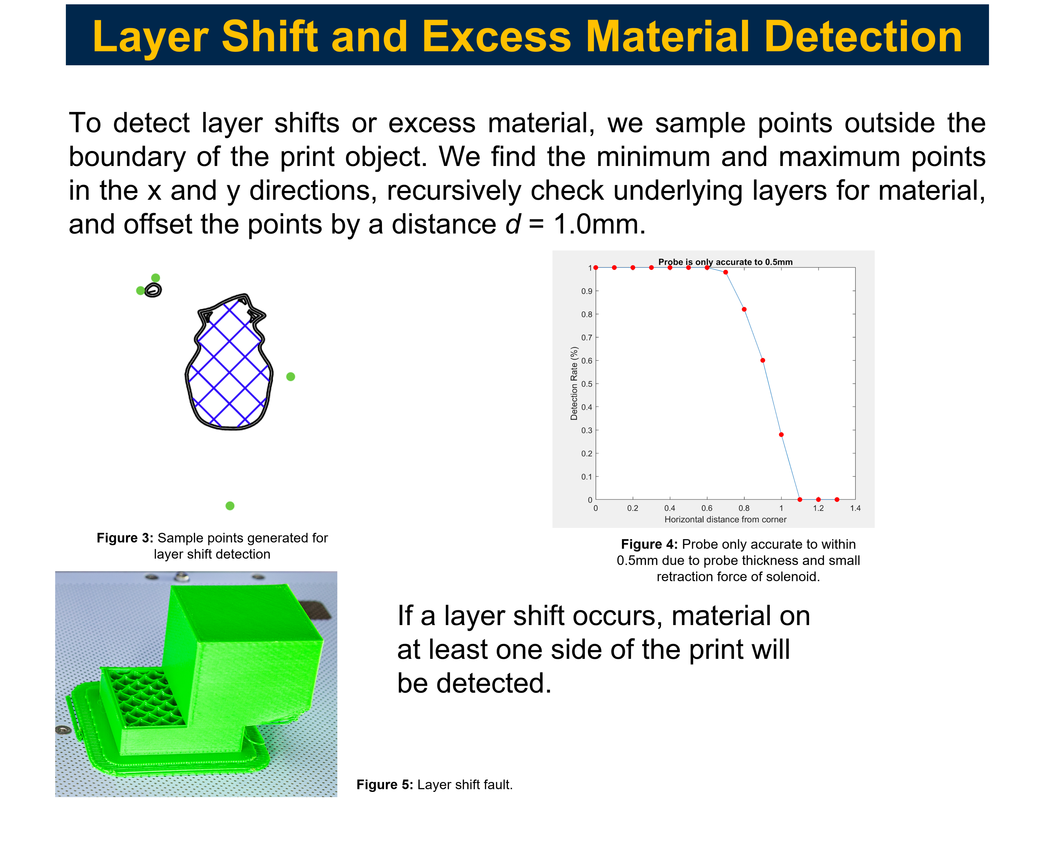
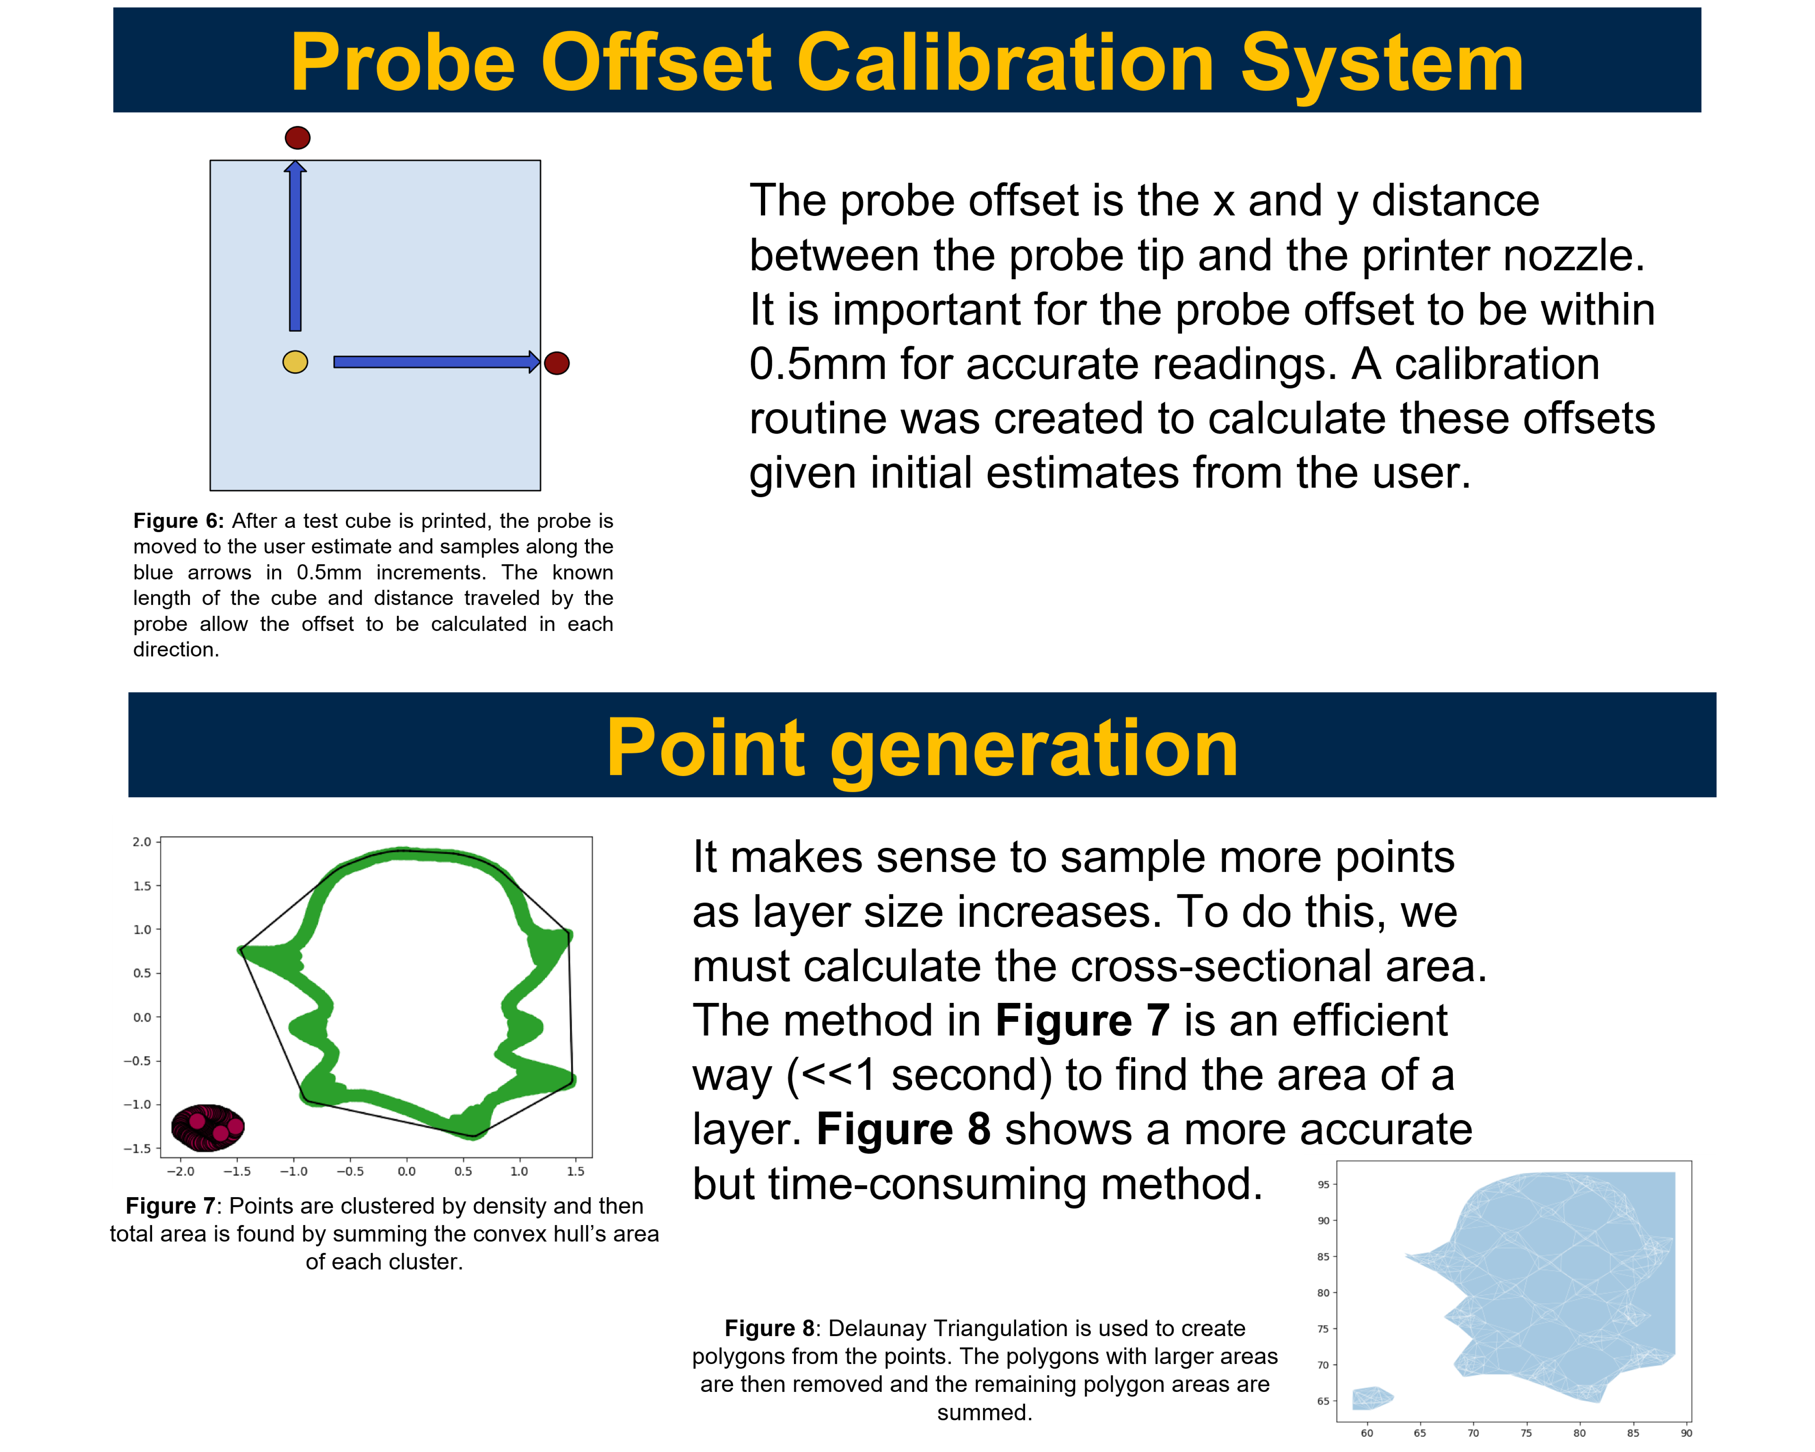
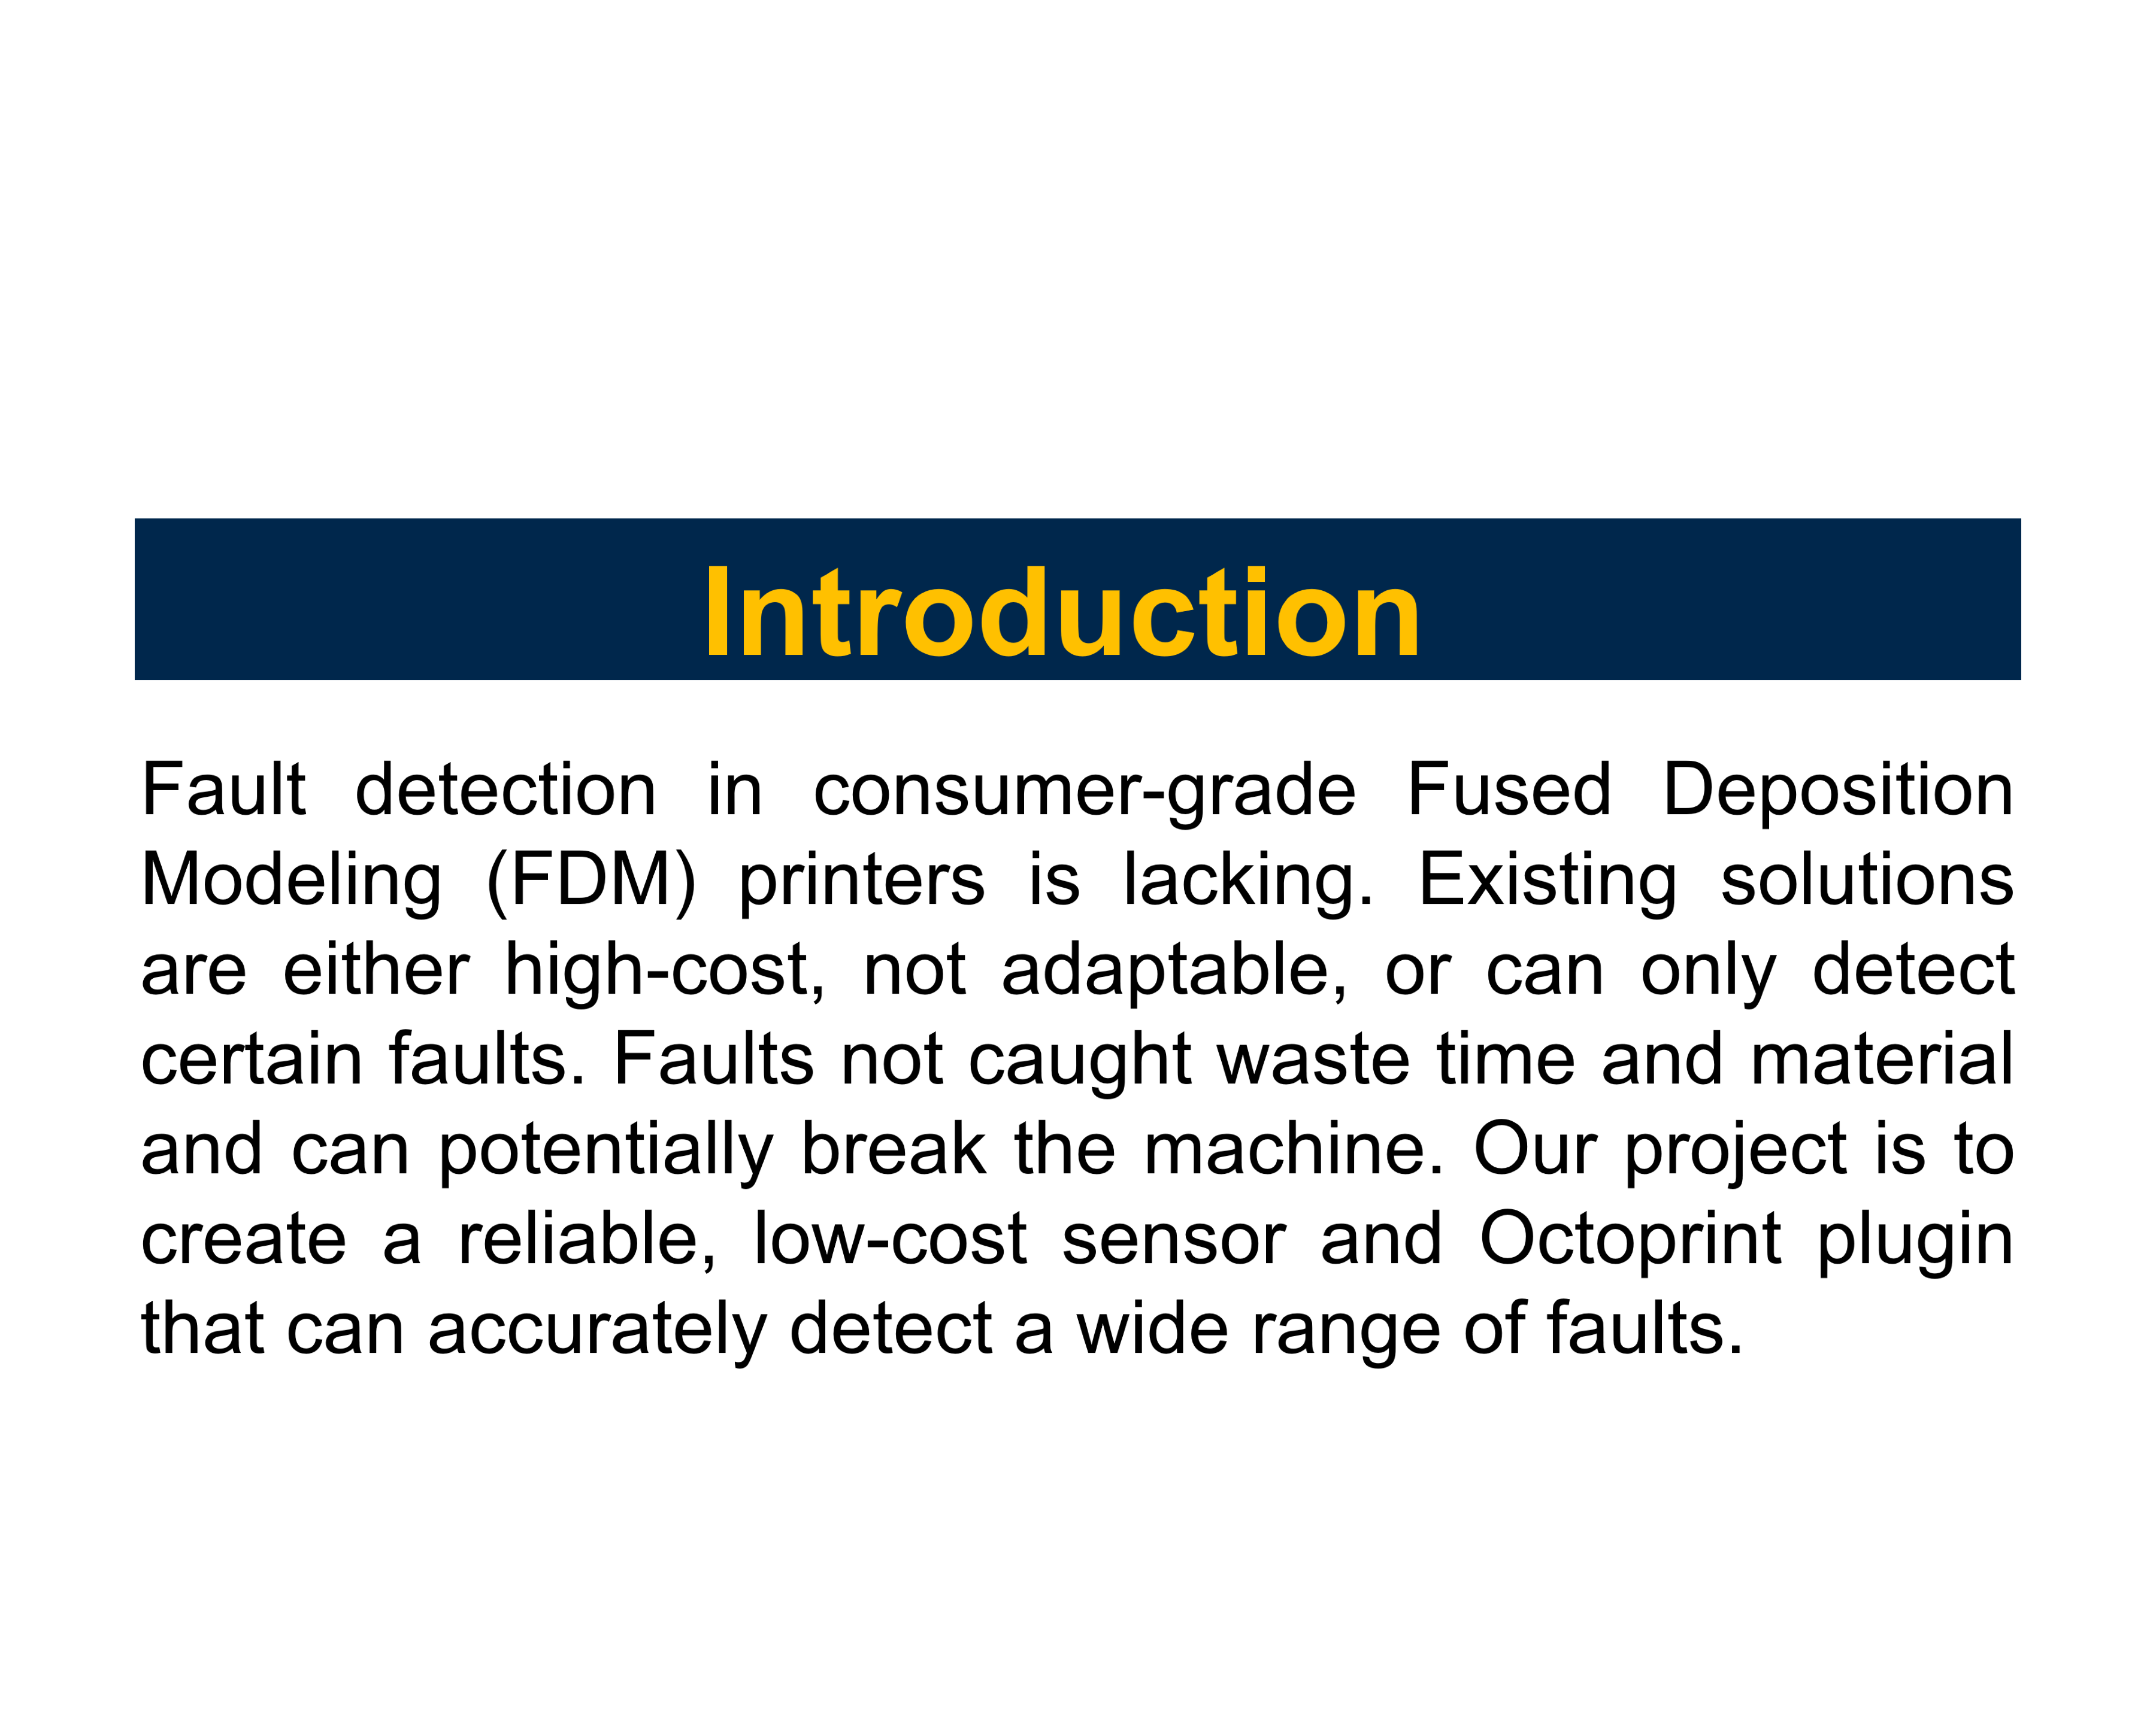
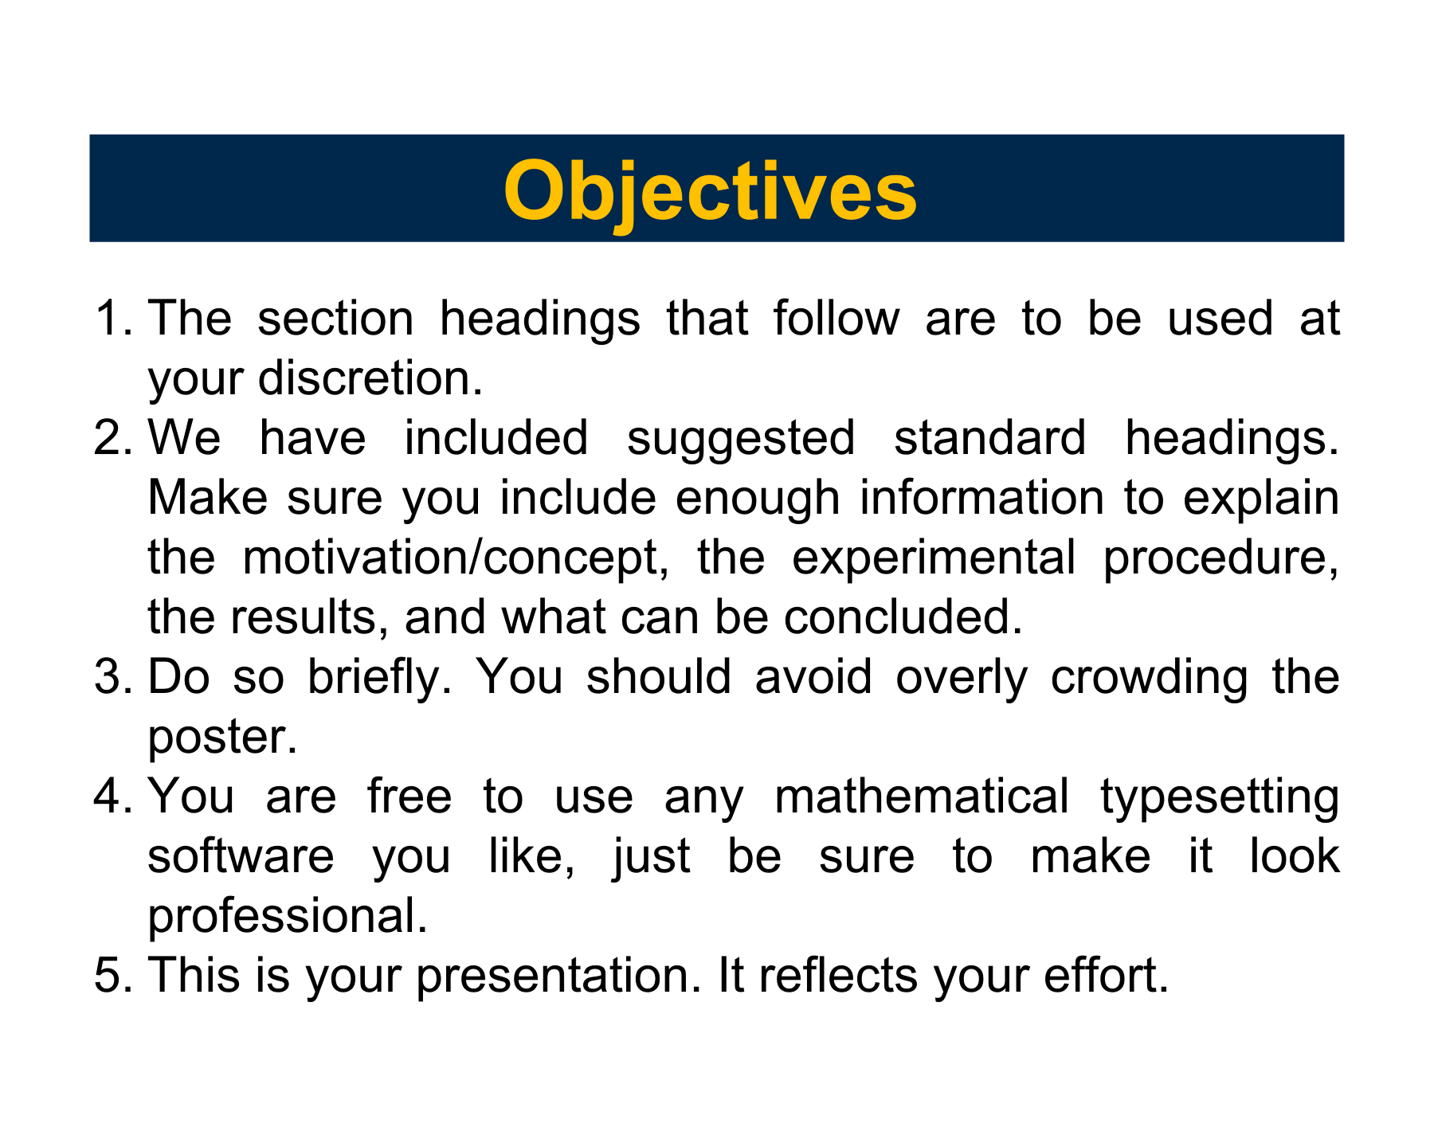
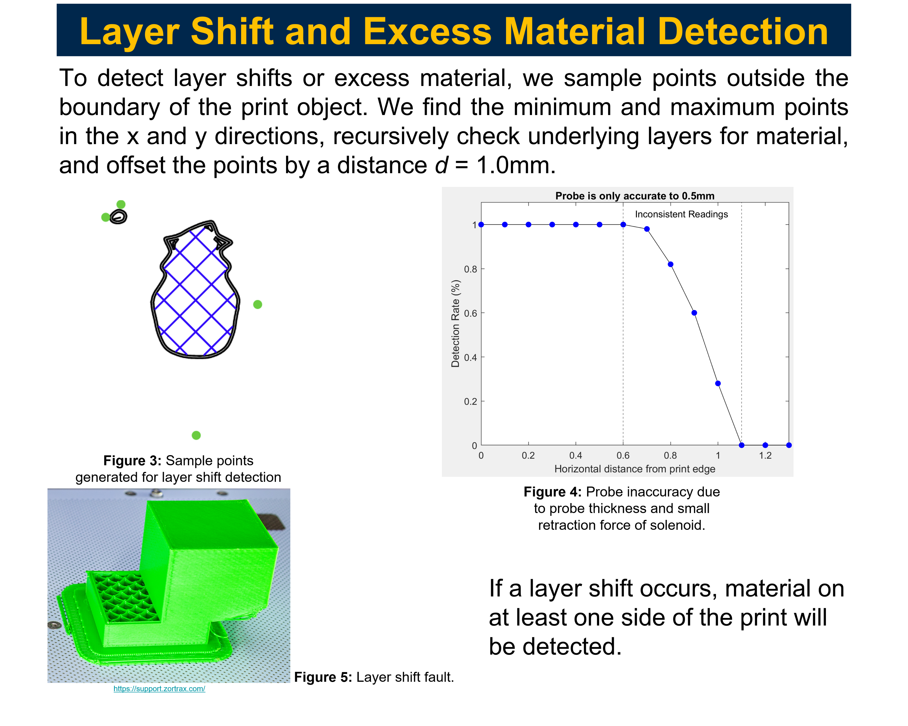
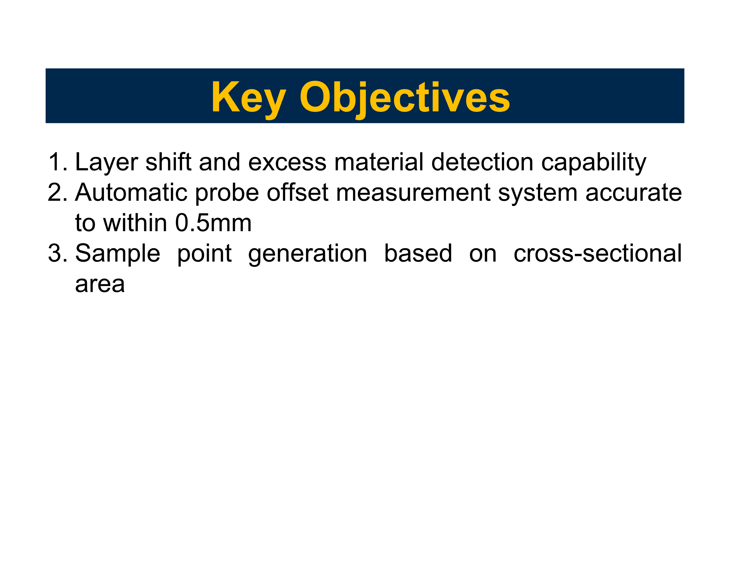
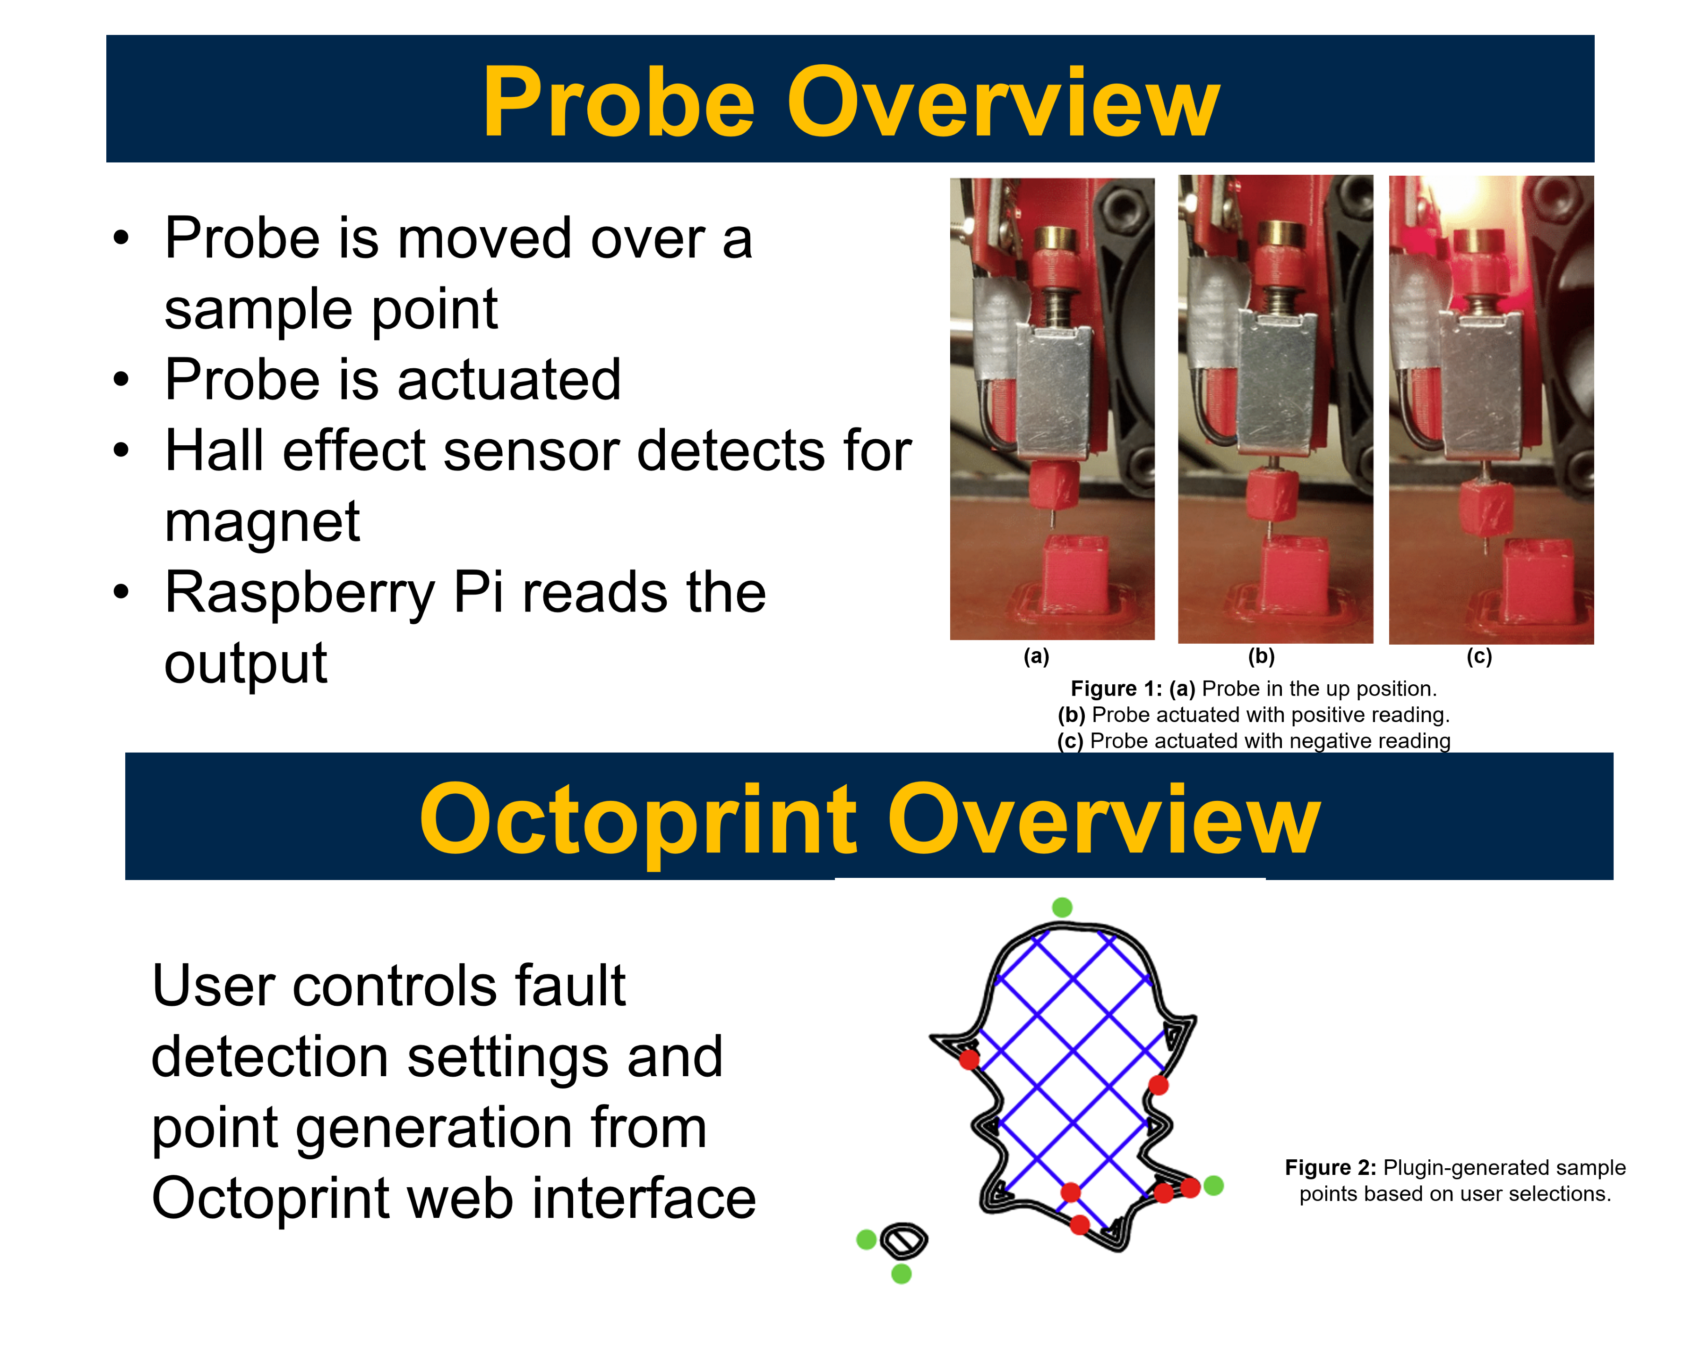
Fault Detection in FDM 3D Printers Using a Low-cost Sensor
Kyle Wilkinson, Samuel Aidala, Chinedum Okwudire
Department of Mechanical Engineering, University of Michigan, Ann Arbor, Michigan.
[ Poster Code ### ]

Slide 2
Introduction
Fault detection in consumer-grade Fused Deposition Modeling (FDM) printers is lacking. Existing solutions are either high-cost, not adaptable, or can only detect certain faults. Faults not caught waste time and material and can potentially break the machine. Our project is to create a reliable, low-cost sensor and Octoprint plugin that can accurately detect a wide range of faults.

Slide 3
Key Objectives
Layer shift and excess material detection capability
Automatic probe offset measurement system accurate to within 0.5mm
Sample point generation based on cross-sectional area

Slide 4
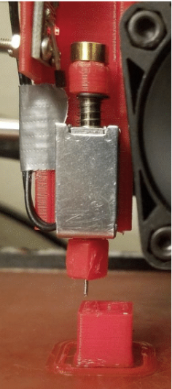
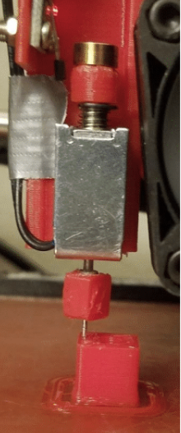
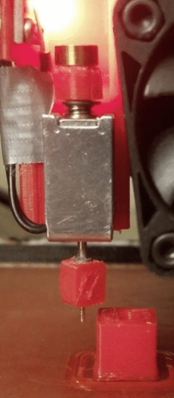
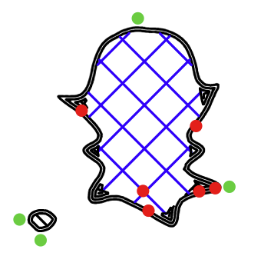
Probe Overview
Probe is moved over a sample point
Probe is actuated
Hall effect sensor detects for magnet
Raspberry Pi reads the output
(a) (b) (c)
Figure 1: (a) Probe in the up position.
(b) Probe actuated with positive reading.
(c) Probe actuated with negative reading
Octoprint Overview
Octoprint is a 3D printer application that allows for remote control of the printer. The user controls the fault detection settings and point generation from the Octoprint web interface.
Figure 2: Plugin-generated sample points based on user selections.
Notes:
It may be good to briefly explain what octoprint is

Slide 5
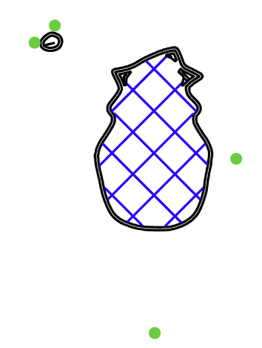
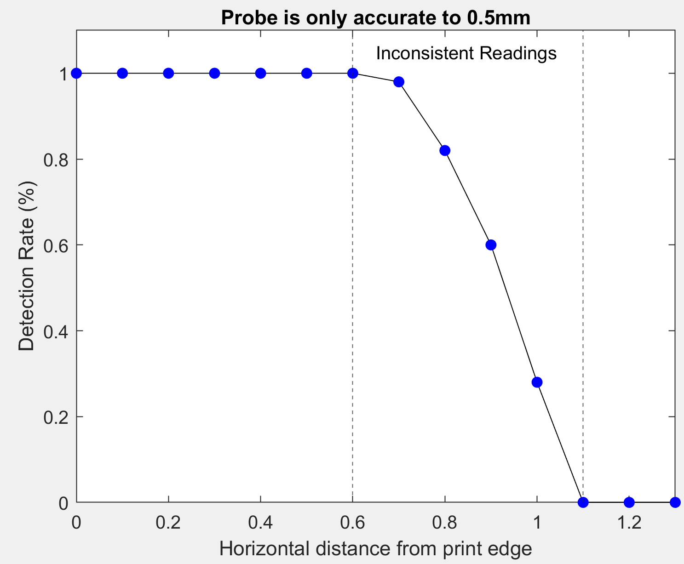
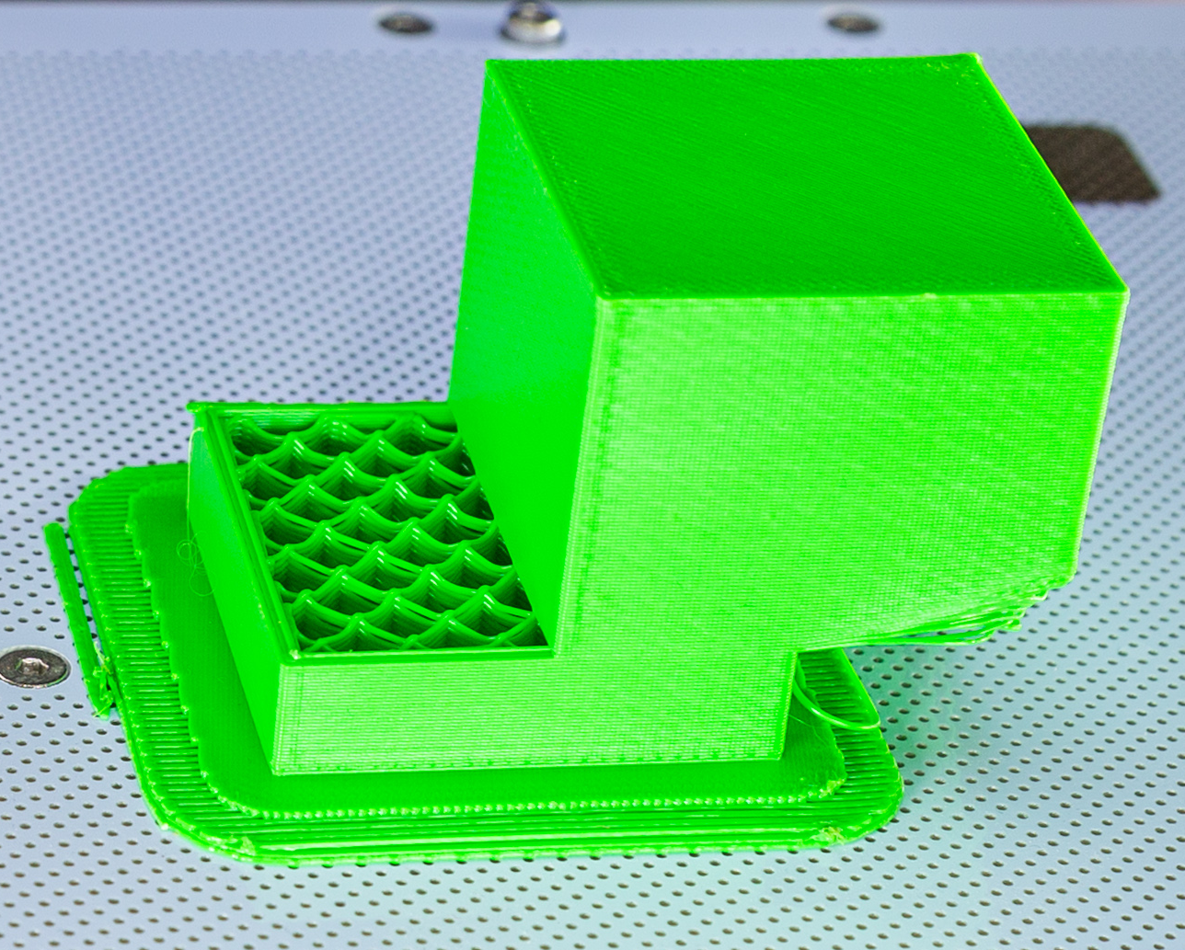
Layer Shift and Excess Material Detection
To detect layer shifts or excess material, we sample points outside the boundary of the print object. We find the minimum and maximum points in the x and y directions, recursively check underlying layers for material, and offset the points by a distance d = 1.0mm.
Figure 3: Sample points generated for layer shift detection
Figure 4: Probe inaccuracy due to probe thickness and small retraction force of solenoid.
If a layer shift occurs, material on at least one side of the print will be detected.
Figure 5: Layer shift fault.
https://support.zortrax.com/
Notes:
Please make the labels and fonts on the figures larger and more legible – espetially figure 4

Slide 6
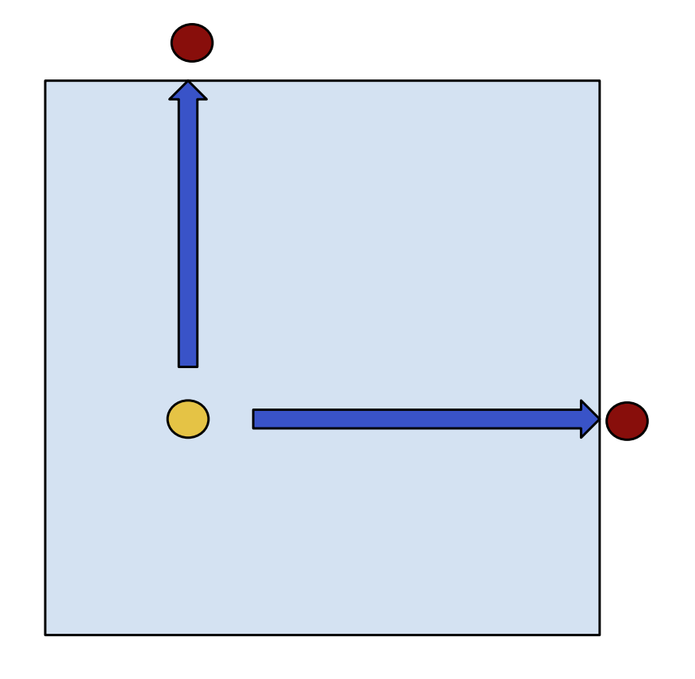
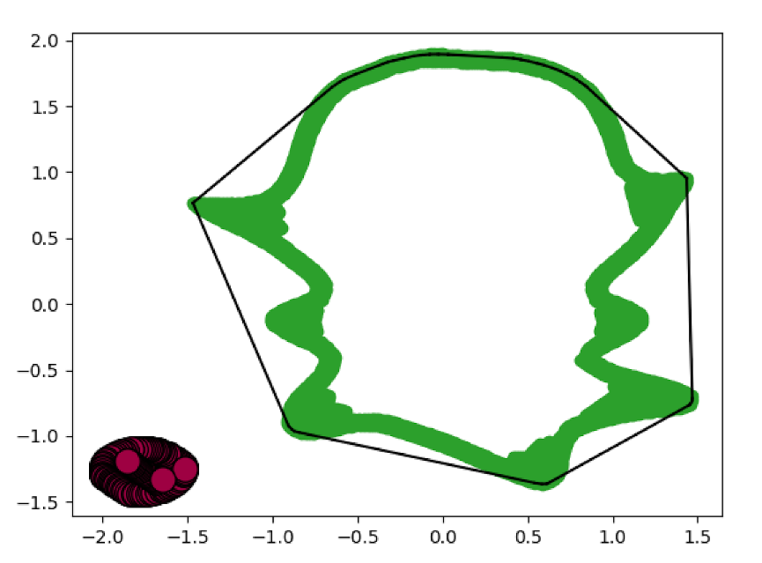
Probe Offset Calibration System
The probe offset is the x and y distance between the probe tip and the printer nozzle. It is important for the probe offset to be within 0.5mm for accurate readings. A calibration routine was created to calculate these offsets given initial estimates from the user. Using a test cube, the user’s error is calculated, and the offsets are corrected.
Figure 6: The probe is moved to the user estimate and samples along the blue arrows in 0.5mm increments.
Sample Point Generation
The number of points sampled on a layer can vary based on the cross-sectional area and reduce unnecessary point sampling. To calculate the area, points are clustered by density and the areas of each cluster’s convex hull are summed. This method is computationally efficient (<<1 second per layer) and yields accurate results for convex shapes.
Figure 7: The area of a cluster is found using its convex hull (black line).
Notes:
The tiny captions on the figures will not be easy to read – and they have too much text. I think you can keep it simple by removing the captions and let the descriptions in the body explain the figures

Slide 7
Conclusions
Layer Shift and Excess Material Detection:
Point computation is fast with large cross sections.
Successful in detecting excess material. Should work for layer shift detection but more testing must be done.
Probe Offset Calibration System:
Successfully calibrates the probe offset within 0.5mm.
Reduces time for user to measure the offset by about 80%.
Sample Point Generation:
Density-based clustering and convex hull calculations are efficient.
Not as accurate for concave cross sections or sections with large holes.
Future Work:
Creation of public documentation detailing how to use the system.
Generation of sample points during the printing process to allow for more computation time without the wait.

Slide 8
Acknowledgement
Thank you to Professor Chinedum Okwudire and Sam Aidala for their guidance.
Thank you to everyone in the Smart and Sustainable Automation (S2A) Lab.
References
Aidala, Samuel N. Development of a Low-Cost Sensor for Fault Detection in FDM 3D Printers.
“Layer Shift Fault.” Troubleshooting: Layer Shifting, Zortrax.

